Slide 1

Design C code which performs all types of sorting methods
-presented by
Savant Omkar Vitthal - 45
Raut Atharva Satish - 43
Wani Pushpak - 1

Slide 2

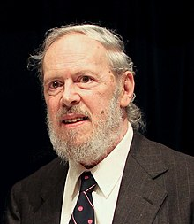
C language
C was originally developed at Bell Labs by Dennis Ritchie between 1972 and 1973 to make utilities running on Unix.
During the 1980s, C gradually gained popularity. It has become one of the most widely used programming languages.

Slide 3

Data Structure
A data structure is a particular way of organizing data in a computer so that it can be used effectively.
A data structure is a collection of data values, the relationships among them, and the functions or operations that can be applied to the data.

Slide 4
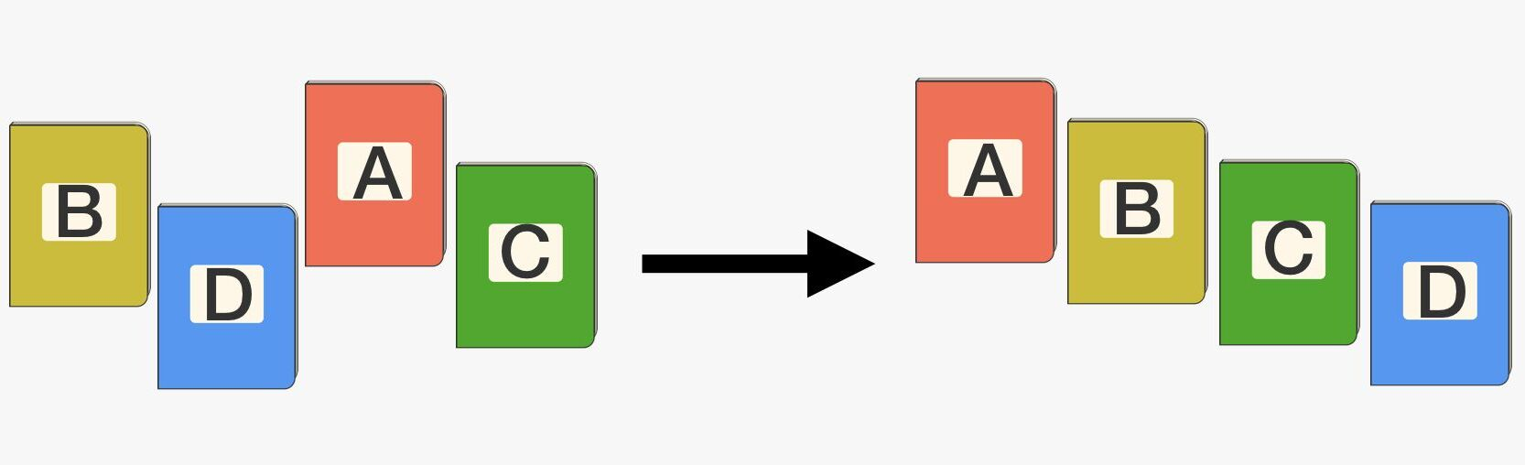
Sorting Algorithm
In computer science, a sorting algorithm is an algorithm that puts elements of a list in a certain order.
The most frequently used orders are numerical order and lexicographical order.

Slide 5
Types of Sorting Algorithm
Bubble sort
Insertion sort
Selection sort

Slide 6
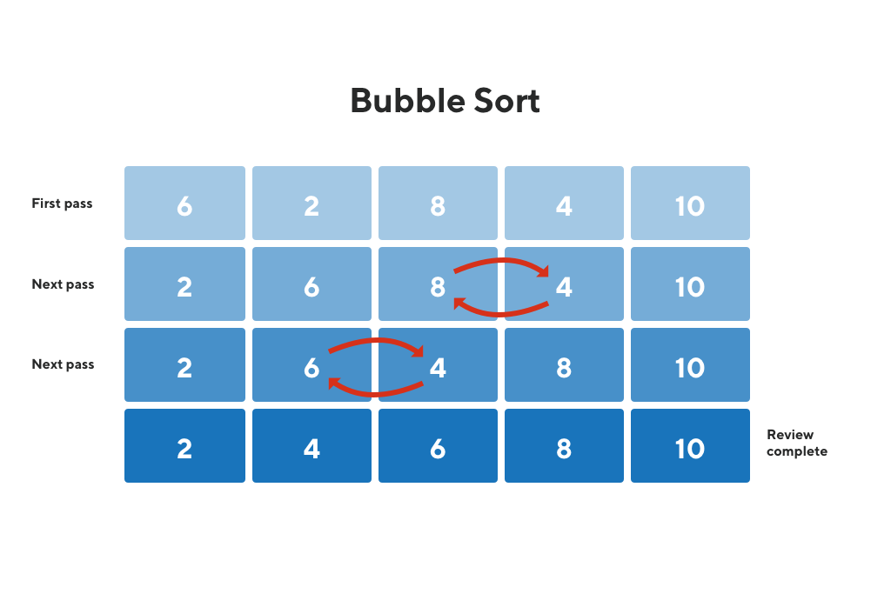
Bubble Sort
Bubble Sort is the simplest sorting algorithm that works by repeatedly swapping the adjacent elements if they are in wrong order.
The pass through the list is repeated until the list is sorted.

Slide 7
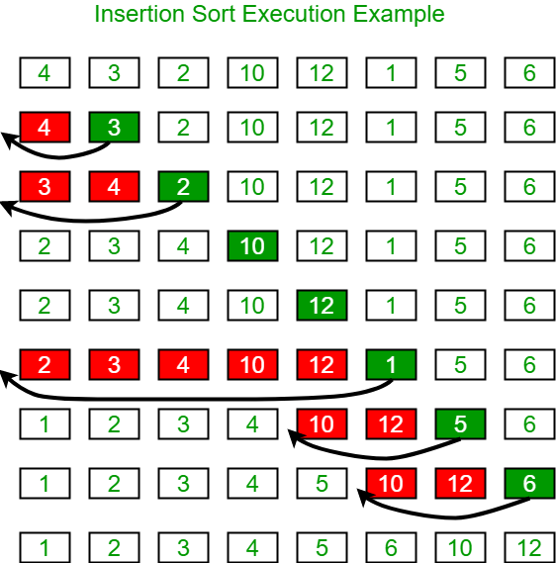
Insertion Sort
Insertion sort is a simple sorting algorithm that builds the final sorted array one item at a time.
Values from the unsorted part are picked and placed at the correct position in the sorted part.

Slide 8
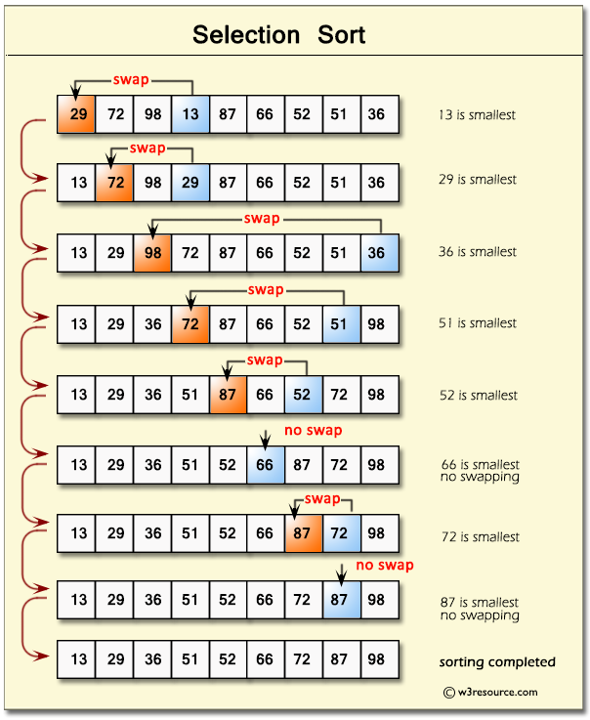
Selection Sort
The selection sort algorithm sorts an array by repeatedly finding the minimum element from unsorted part and putting it at the beginning.
In every iteration of selection sort, the minimum element from the unsorted subarray is picked and moved to the sorted subarray.

Slide 9
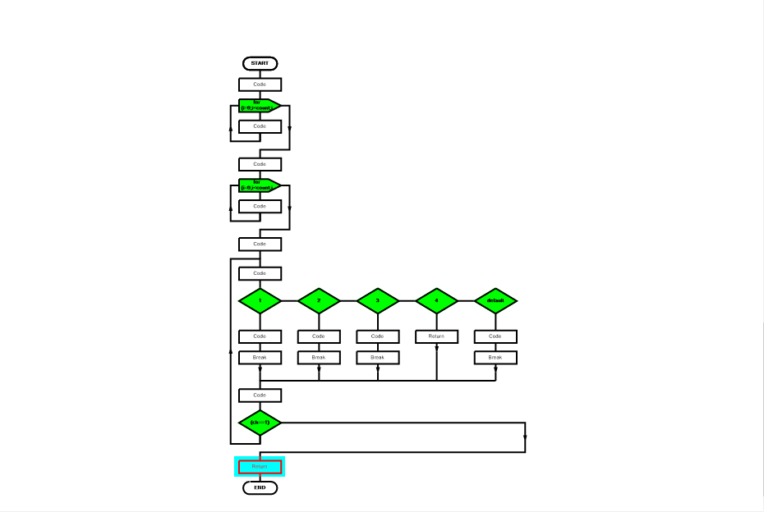
Flowchart:

Slide 10
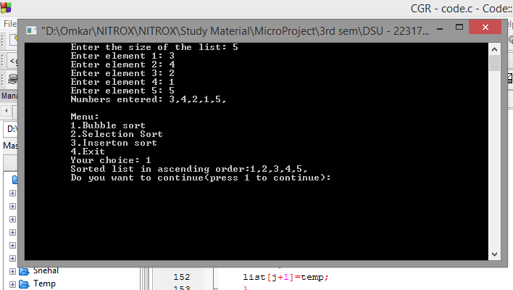
Output:

Slide 11

Analysis
A data structure is a collection of data type 'values' which are stored and organized in such a way that it allows for efficient access and modification. ... When we think of data structures, there are generally four forms: Linear: arrays, lists. Tree: binary, heaps, space partitioning

Slide 12


Conclusion
Sorting refers to arranging data in a particular format.
Sorting algorithm specifies the way to arrange data in a particular order.
It may be in Numerical order or Alphabetical order. This is done to maintain efficiency of data structure

Slide 13

Thank You!

